Slide 1
Frontend Development AngularJS
Pregatit de: Alexandru Dima Data: 20.10.2014

Slide 2
Topics - Introduction - Dependency Injection - Templates - Modules - Directives - Create an application - Controllers - Scopes

Slide 3
Introduction
MVW Framework
Written in JavaScript
Two Way Binding
Extends HTML vocabulary
Compile templates
Scope
Dependency Injection

Slide 4
What is AngularJS?
It is a JavaScript framework designed by Google for developing properly architectured web applications
Follows the MVC pattern, actually the MVVM particularization
It is NOT a library for manipulating DOM, like jQuery.
Mainly used for SPA (Single Page Apps)
Enhances HTML with custom tags/attributes
Reuses code with the DI (Dependency Injection) mechanism

Slide 5
MVW
Model View Whatever: MVC is a design pattern for dividing an application into different parts (called Model, View and Controller), each with distinct responsibilities. AngularJS does not implement MVC in the traditional sense, but rather something closer to MVVM (Model-View-ViewModel)
Two-way-data-binding: It is the automatic synchronization of data between model and view components.
Scope: These are objects that refer to the model. They act as a glue between controller and view.
Controller: These are Javascript functions that are bound to a particular scope.
Dependency Injection: AngularJS has a built-in dependency injection subsystem that helps the developer by making the application easier to develop, understand, and test.

Slide 6
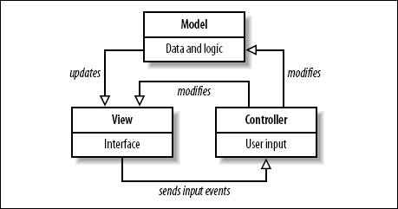
MVC
Model View Controller or MVC as it is popularly called, is a software design pattern for developing web applications
Model - It is the lowest level of the pattern responsible for maintaining data.
View - It is responsible for displaying all or a portion of the data to the user.
Controller - It is a software Code that controls the interactions between the Model and View.

Slide 7
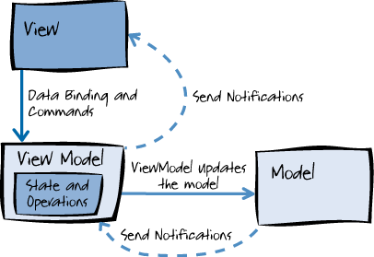
MVVM

Slide 8
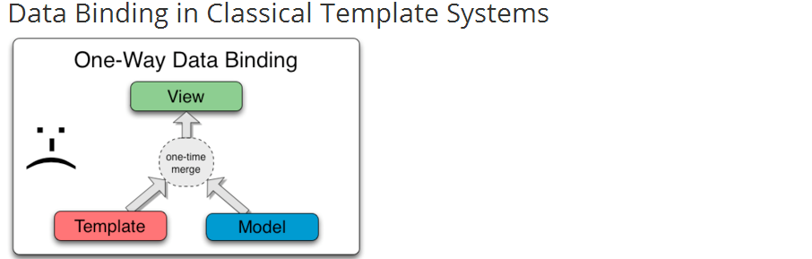
One Way Data binding

Slide 9
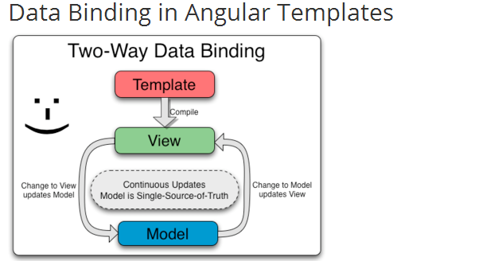
Two way data binding

Slide 10
AngularJS advantages
AngularJS provides capability to create Single Page Application in a very clean and maintainable way.
AngularJS provides data binding capability to HTML thus giving user a rich and responsive experience
AngularJS code is unit testable.
AngularJS uses dependency injection and make use of separation of concerns.
AngularJS provides reusable components.
With AngularJS, developer write less code and get more functionality.
In AngularJS, views are pure html pages, and controllers written in javascript do the business processing.

Slide 11
Application
An application is build from modules;
Module:
A container for parts of the application;
Easy to understand;
Can be used as reusable components;

Slide 12
Application
Initializes the built-in objects;
Creates the AngularJS scopes;
Starts the compiler;

Slide 13
Application
To initialize an AngularJS application:
angular.module(‘appName', []);
<ANY ng-app=“appName”…>…</ANY>

Slide 14
Application
AngularJS built-in objects:
angular
$rootScope
$scope
etc

Slide 15
Directives
Extend angular vocabulary
Markers on DOM elements
Types:
HTML attributes
HTML elements
CSS classes
HTML comments
Add specific behavior
Transform and manipulate DOM

Slide 16
AngularJS directives
ng-app : This directive defines and links an AngularJS application to HTML.
Example:
<div ng-app=“myApp”>/*Here we have an angular compiled HTML*/</div>
ng-controller tells AngularJS what controller to use with the view.
Example: <div ng-app=“myApp”>
<div ng-controller=“MyC”>
/*Here we have HTML code manipulated only by the MyC controller*/
</div></div>
<ANY ng-controller=""> ... </ANY>

Slide 17
Controllers
Functions
Control interaction with templates
Add behavior
Declaration:
myApp.controller(‘MyController‘, [‘dependency’, function(dependency) { … }])
myApp.controller(‘MyController‘, function(dependency) { … })
Use:
ng-controller=“MyController”
Inside $routeProvider

Slide 18
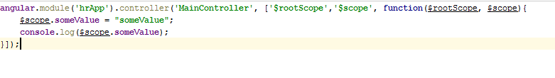
Dependency Injection
Dependency Injection (DI) is a software design pattern that deals with how components get hold of their dependencies.
For example, in the declaration of a controller, the AngularJS Dependency Injection engine is responsible for instantiating the right dependencies

Slide 19

AngularJS directives
ng-bind: tells Angular to replace the text content of the specified HTML element with the value of a given expression, and to update the text content when the value of that expression changes.
ng-model : This directive binds the values of AngularJS application data to HTML input controls.
<ANY ng-bind=""> ... </ANY>

Slide 20
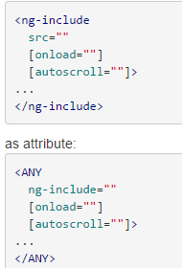
Angularjs directives
ng-include - Fetches, compiles and includes an external HTML fragment.

Slide 21
Workshop: AngularJS Application

Slide 22
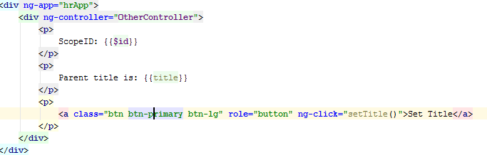


AngularJS directives
ng-click - The ngClick directive allows you to specify custom behavior when an element is clicked.
ng-show – the ng-show directive shows or hides the given HTML element based on the expression provided to the ng-show attribute
ng-hide – the ng-hide directive shows or hides the given HTML element based on the expression provided to the ng-hide attribute
ng-if – similar to ng-hide/ng-show. The difference between ng-if and ng-show is that ng-if actually removes the HTML portion, while ng-show shows/hides it with CSS.

Slide 23
Scope
Object that represents the model
Nested structure
$rootScope – main scope
Other scopes are children of $rootScope or other child scopes

Slide 24
Workshop: AngularJS Application

Slide 25
Directives
ng-app: initialize an AngularJS application
ng-view: main template
ng-include: include HTML templates
ng-show/ng-hide: show/hide elements
ng-click: triggers on user click and executes an expression
ng-model: binds a model variable to an element ng-controller: binds a controller to the current element

Slide 26
Ng-repeat
ng-repeat directive instantiates a template once per item from a collection. Each template instance gets its own scope, where the given loop variable is set to the current collection item, and $index is set to the item index or key.

Slide 27
Workshop: AngularJS Bindings & Scopes

Slide 28
Questions?

Slide 29
Thank you!

